Slide 1
Owner-occupied housing and the EU HICP
UN Network of Economic Statisticians
Sprint on OOH, 2nd meeting, 20 Sept 2022
Paul Konijn, Eurostat

Slide 2
HICP vs national CPIs
HICP = Harmonised Index of Consumer Prices
Comparable across all EU countries, based on harmonised definitions and methods
Main uses: price stability objective of ECB; convergence criteria for accession to euro zone
CPI = Consumer Price Index
Specific for each country, using national definitions and methods, i.e. not comparable
Important uses: indexation of pensions, social security, minimum wages, rents, etc.

Slide 3
HICP and OOH
HICP was created in 90s for the purposes of monetary union
Includes household monetary consumption transactions only
Main exclusion: owner-occupied housing (OOH) = cost of living in your own house
Lack of international consensus on the best way to include OOH in consumer price indices
ECB has over the years repeatedly requested the inclusion of OOH in the HICP, because of its significance and the impact of the exclusion on comparability of the HICP (within EU and with countries outside EU)

Slide 4
Four main approaches to measuring OOH, none perfect
Rental equivalence: how much owner-occupiers would have to pay to rent their dwelling -> imputed price, not monetary; dominant approach used in national accounts; difficult for countries with small rental market
Net acquisitions: uses prices paid by households for the acquisition and ownership of dwellings for own use -> monetary, but goes beyond consumption and includes asset elements in a CPI
User costs: estimates the opportunity cost of the invested capital value, plus depreciation less capital gains -> includes modelling, difficult to implement
Payments: based on cash outlays by owner-occupiers, e.g. on mortgage interest, down payments, etc. -> depends on interest rates, not suitable for monetary policy
Additional challenge for HICP: find a harmonised approach

Slide 5
Inclusion of OOH in national CPIs
Rental equivalence approach | Acquisitions approach | User cost approach | Payments approach | Exclusion of OOH
Denmark Germany The Netherlands Slovakia ------------------------------ Norway Switzerland ------------------------------ USA UK Japan | Finland Czechia ------------------------------ ------------------------------ Australia New Zealand | Sweden ---------------------------- Iceland ---------------------------- Canada | Ireland Austria (until 2019) ---------------------------- ---------------------------- | Remaining EU countries ------------------------- --------------------------

Slide 6
Owner-occupied housing price index (OOHPI)
A separate harmonised index on OOH was developed in all EU countries, for possible integration with the HICP
Based on net acquisition approach, including costs of acquisition as well as costs of ownership
Data are available since reference year 2010; legal obligation
Quarterly index, available around 3 months after reference quarter
Note: not to be confused with the House Price Index, which covers all transactions of dwellings by households

Slide 7
Breakdown of the OOHPI
Expenditure categories | Item weights (parts per 1000) for EA19 in 2022
O.1.1. Acquisitions of dwellings | 779.2
O.1.1.1. New dwellings | 648.2
O.1.1.1.1. Purchases of newly built dwellings | 211.5
O.1.1.1.2. Self-build dwellings and major renovations | 436.7
O.1.1.2. Existing dwellings new to households | 5.5
O.1.1.3. Other services related to the acquisition of dwellings | 125.4
O.1.2. Ownership of dwellings | 220.8
O.1.2.1. Major repairs and maintenance | 185.0
O.1.2.2. Insurance connected with dwellings | 27.5
O.1.2.3. Other services related to ownership of dwellings | 8.4

Slide 8
Relation with national accounts
O.1.1. Acquisition of dwellings = gross fixed capital formation of households in their capacity as producers of own-account housing services
O.1.2. Ownership of dwellings = intermediate consumption of households in their capacity as producers of own-account housing services
HICP = final monetary consumption expenditure of households
HICP + OOHPI = monetary expenditures, whether current or capital, of households for direct final consumption or for use in the production of housing services for own consumption (cf. Peter Hill, 1996)

Slide 9
Treatment of land
Excluded from expenditures used as weights, as per national accounts definition of gross fixed capital formation
Included in the transaction prices used for estimating the indices for
Purchases of new dwellings
Existing dwellings new to households
Other services related to acquisition of dwellings
(overall share: 342.5)
Excluded for Self-build dwellings and major renovations (share: 436.7), which is based on construction price or cost indices

Slide 10
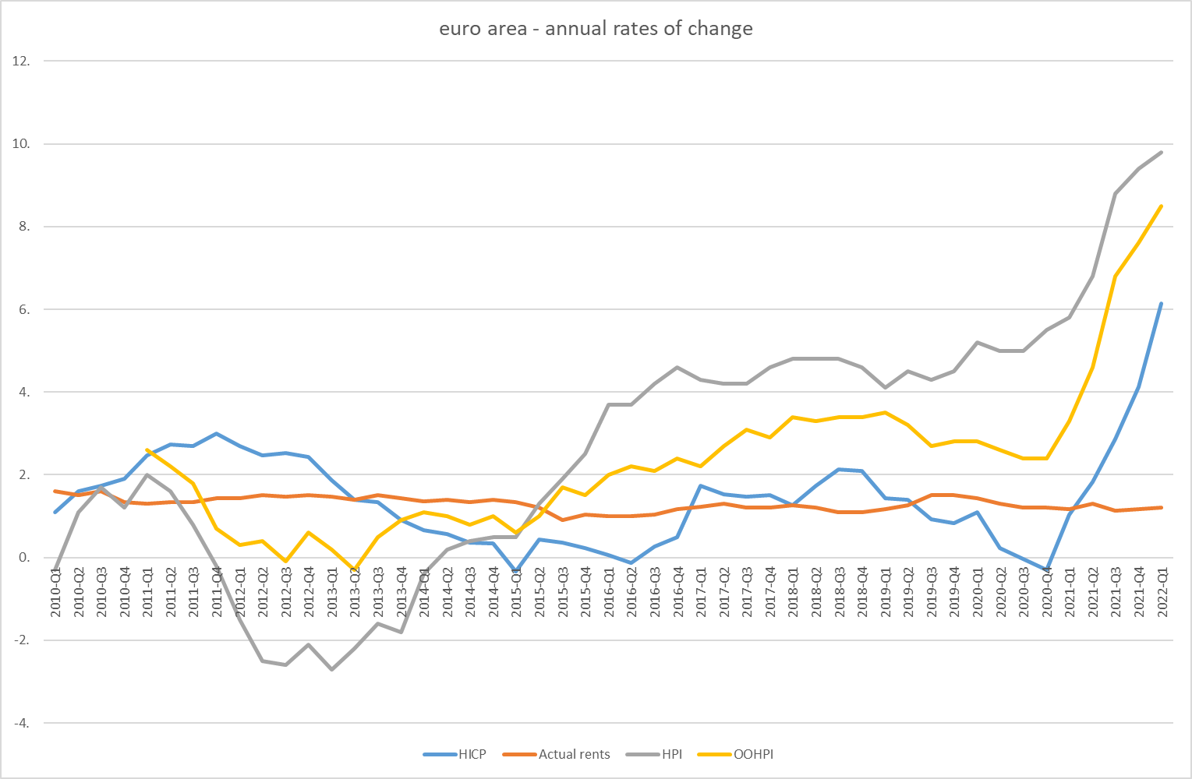

Slide 11
2018 Commission report to European Parliament and Council
OOHPI currently not suitable for integration into coverage of HICP, because:
Frequency and timeliness below HICP standards
No solution found yet for separating consumption and investment elements of house purchases

Slide 12
ECB Monetary Policy Strategy Review
Outcome published 8 July 2021
Covering all aspects of monetary policy, including measurement of inflation (HICP)
Most important subject in relation to HICP: owner-occupied housing (OOH)
ECB confirmed that HICP remains the appropriate index for quantifying ECB’s price stability objective for the euro area
ECB proposed roadmap towards inclusion of OOH

Slide 13
ECB recommendations on OOH
Support for the use of the net acquisitions approach
Request to produce a separate quarterly combined index of HICP with OOHPI
Further research on separating consumption from investment elements in the OOHPI
Reminder that the long-term aim is integration of OOH into HICP on a monthly basis.

Slide 14
Discussions in ESS
Concerns raised by several Member States on
Risk to credibility of HICP and national CPIs (of publishing combined indicator)
Conceptual issues -> some would prefer rental equivalence approach
Decision to set up a dedicated Task Force to prepare a response to the ECB recommendations on OOH

Slide 15
Task Force Owner-Occupied Housing
Mandate: to assist Eurostat in drafting a public ESS response to ECB recommendations
Task Force composition: AT, DK, FI, FR, IE, IT, LT, NL, PL, PT, ECB, OECD, ECFIN
Meeting every month from February to June, again in September and October
Carrying out a survey to EU and EFTA NSIs on feasibility and appropriateness of different approaches to OOH
Aim for conclusion at ESS Committee in February 2023

Slide 16
Conclusions
No changes to HICP to be expected in near future
Discussions are ongoing on the future of OOH in relation to the HICP
One proposal is a separate quarterly index combining a measure of OOH with the HICP, without changing the HICP itself
No (direct) impact on national CPIs

Slide 17
Thank you
Contact: ESTAT-PRICE-STATISTICS@EC.EUROPA.EU
Notes:
Update/add/delete parts of the copy right notice where appropriate.
More information: https://myintracomm.ec.europa.eu/corp/intellectual-property/Documents/2019_Reuse-guidelines%28CC-BY%29.pdf

